Slide 1
Empirical reproduction,
forensic audit, and scalable
streaming detection of DDoS attacks
Auditing Ahmad et al. (IEEE Access, 2026) and testing production-scale detection on CICDDoS2019.

Slide 2
Five objectives drove the audit
A rigorous empirical verification protocol designed to evaluate mathematical rigor, streaming infrastructure, and cross-day generalization.
01
02
03
04
05
Audit Paper Math
Test "Kafka Boost"
Cross-Day Split
Zero-Day & Ports
Scale to 70M Rows
Establish authentic Day 1 train / Day 2 test benchmarks, eliminating temporal overlap.
Measure robustness against unseen attack vectors without shortcut port features.
Scrutinize published confusion matrices, sample sizes, and arithmetic consistency.
Compare streaming pipelines against identical offline batch inference runs.
Process the full 30 GB dataset out-of-core on commodity Colab GPU infrastructure.
2
Notes:
Walk through the five core audit pillars: verifying arithmetic integrity, isolating streaming effects, enforcing clean temporal separation, testing generalization without shortcut ports, and scaling to full dataset volume.

Slide 3
The published story breaks at the denominator
270
2M+
99.9996%
flows in the published confusion matrices
flows claimed in the paper
of the claimed sample absent from the matrices
Published confusion matrices sum to exactly N = 270 flows, despite a claim of more than 2 million. The full dataset contains 70,427,637 flows across 18 CSVs. Our audit tests mathematical consistency, streaming equivalence, cross-day generalization, and out-of-core scalability.
2

Slide 4
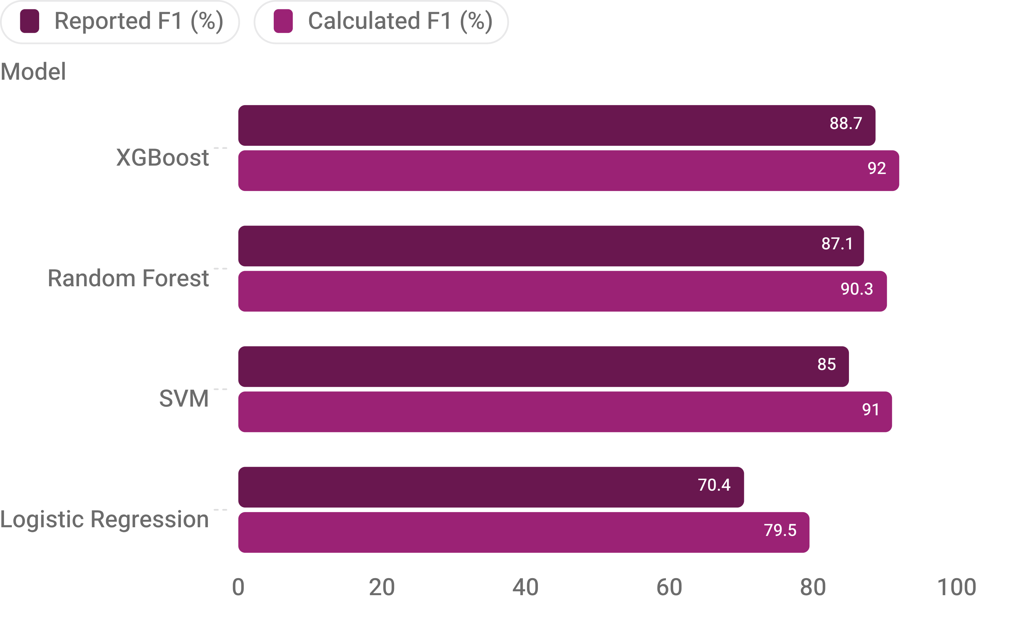
Reported F1 scores do not match their own confusion matrices
9.11 pp
Largest gap
Logistic Regression: reported 70.4% versus calculated 79.51%.
3

Slide 5
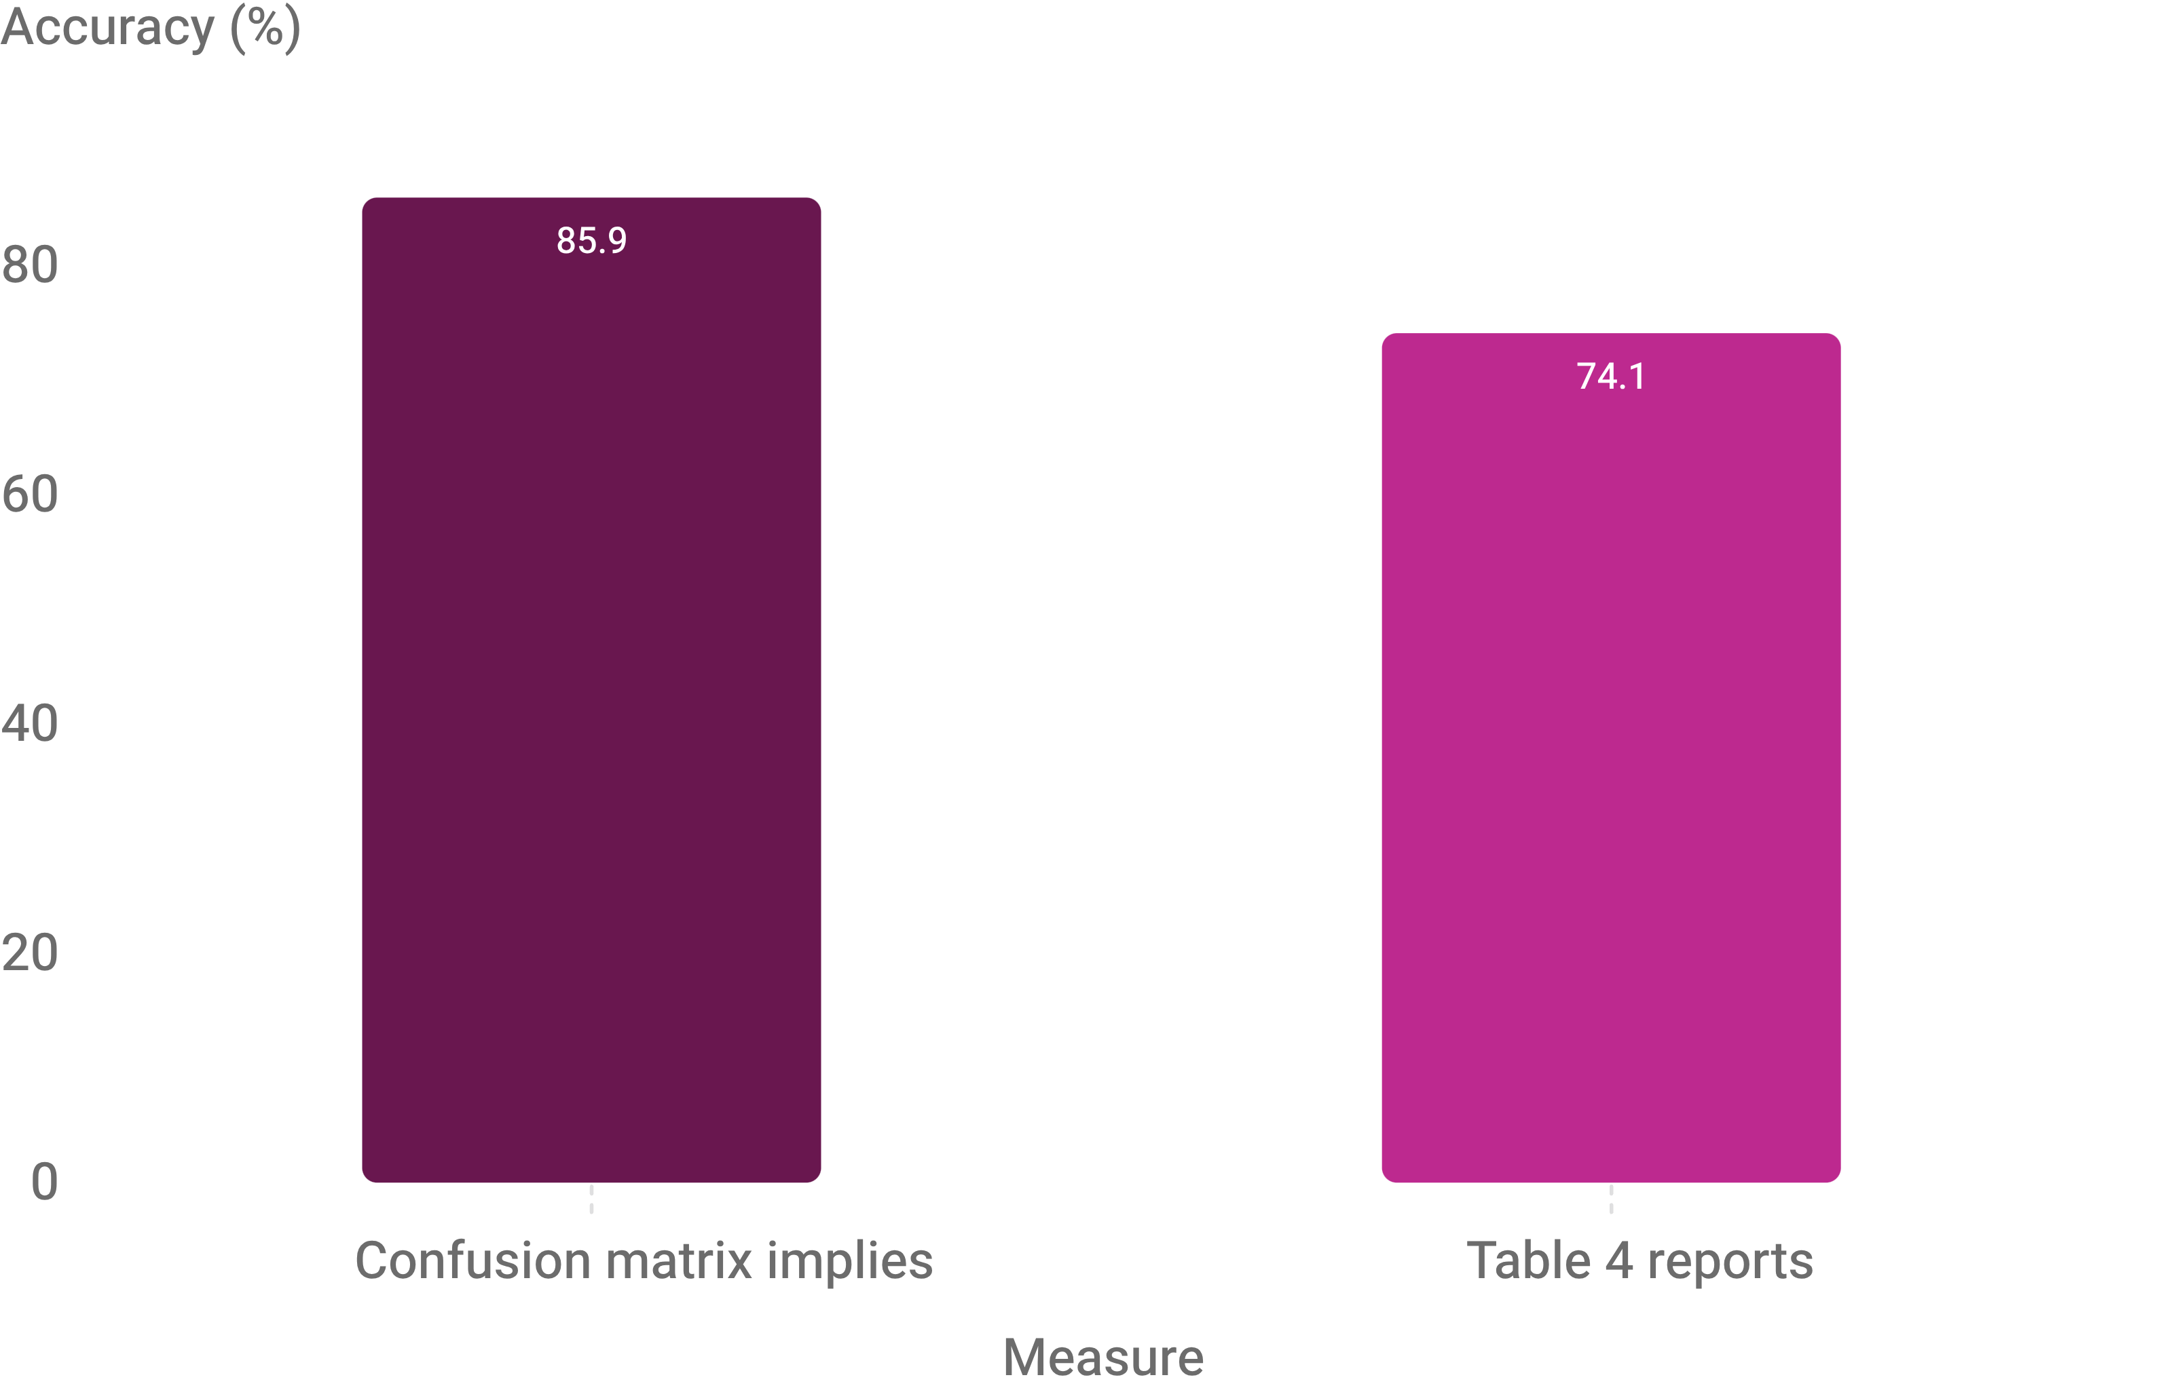
A second contradiction appears in the reported accuracy
11.8 pp
discrepancy for Logistic Regression
4

Slide 6
Three setups, one honest benchmark
Demonstrating how evaluation topology dictates reported accuracy through packet correlation and temporal memorization.
SETUP A
SETUP B
SETUP C · AUDIT STANDARD
99.97%
100.00%
98.4 –
98.98%
Random 80/20 Split (Day 1)
Time Split (Within Day 1)
Severe packet leakage. Packets from identical connection bursts are distributed across train and test sets, artificially inflating metrics.
Memorization artifact. The model overfits to the active tool signatures and packet structures of that specific day's attack generation toolset.
Cross-Day Benchmark
Train Day 1, test Day 2
4
Notes:
Explain how setup choice completely alters findings. Random split leaks packets (99.97%), chronological split within a day memorizes tools (100%), but rigorous cross-day separation proves the real benchmark sits around 98.4% to 99.0%.

Slide 7
Tree ensembles hold up across days
Model | Accuracy | Precision | Recall | F1-Score
Spark RF (Streaming) | 98.98% | 99.02% | 98.94% | 98.98%
Scikit-Learn RF | 98.70% | 98.54% | 98.78% | 98.66%
GPU XGBoost (CUDA) | 98.40% | 98.21% | 99.82% | 99.01%
Spark LinearSVC | 97.55% | 97.60% | 97.50% | 97.55%
Logistic Regression | 89.94% | 99.07% | 88.25% | 93.35%
Gaussian Naive Bayes | 36.43% | 83.09% | 25.77% | 39.34%
Cross-day benchmark across five fixed seeds.
7

Slide 8
Kafka adds speed, not accuracy
Auditing the purported 3% to 7% accuracy increase attributed to streaming pipelines over batch inference.
THE ORIGINAL CLAIM
EMPIRICAL AUDIT RESULT
Claimed +3% to +7% Gain
100.00%
The paper asserted that streaming through Kafka and Spark Structured Streaming micro-batches lifted XGBoost accuracy from 92% to 95%.
Identical Predictions · Zero Variance
Running identical data through offline batch and Spark micro-batches produced an exact 1:1 prediction match. Kafka confers zero predictive advantage.
Hypothesis: transport infrastructure somehow alters mathematical inference.
Production throughput: 14,125 flows/second at a median latency of 33.82 ms.
7
Notes:
Directly debunk the claim that streaming infrastructure boosts model accuracy. Streaming identical inputs yields 100.00% identical outputs compared to batch inference; its true value is low latency and high throughput.

Slide 9
Zero-day detection works, but shortcuts still need to be exposed
Unseen attack
Remove Destination Port
Portmap appears only on Day 2 and remains unseen during Day 1 training.
99.49 → 89.26%
99.52–99.95%
Random Forest accuracy in the shortcut test.
recall; detection failure below 0.48%
Remove Port + Duration + ACK
32.75%
Random Forest accuracy; Logistic Regression falls to 25.90% specificity.
9

Slide 10
Only 76 attacks missed out of 128,391
TRUE POSITIVES
TRUE NEGATIVES
FALSE POSITIVES
FALSE NEGATIVES
128,315
42,868
2,195
76
99.94% Recall
95.13% Specificity
4.87% False Alarms
0.06% Miss Rate
Attacking flows accurately identified and mitigated.
Benign connections permitted without disruption.
Innocent connections flagged as malicious.
Only 76 attack flows evaded classification.
6
Notes:
Emphasize the scale and fidelity: testing 173,454 flows rather than 270 yields 99.94% recall with only 76 misses out of over 128,000 attacks, preserving legitimate users.

